Slide 1
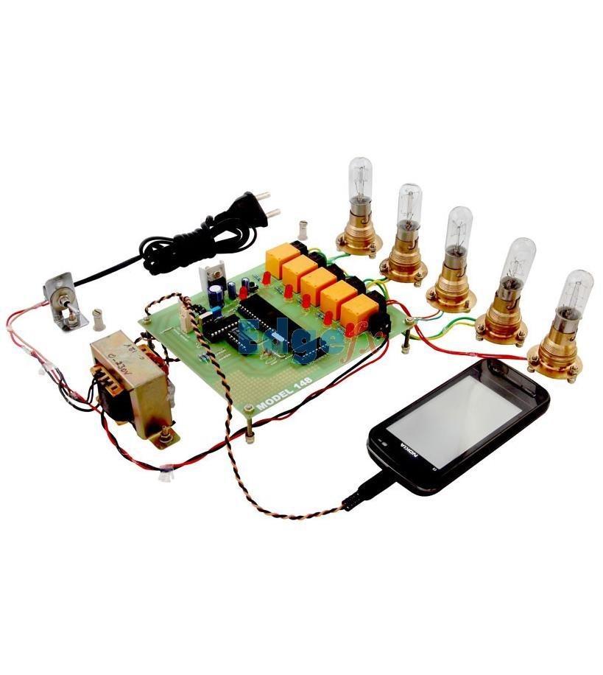
LOAD CONTROL SYSTEM USING DTMF
VIDYA JYOTHI INSTITUTE OF TECHNOLOGY (Autonomous)
Under the guidance of:
K.SANTHIPRIYA
Assistant Professor
By : TEAM-8
P.VAISHNAVI(22911A3542)
A.SANTHOSH(22911A3504)
P.VIGNESH GOUD(22911A3543)
D.ABHISHEK(23915A3502)

Slide 2
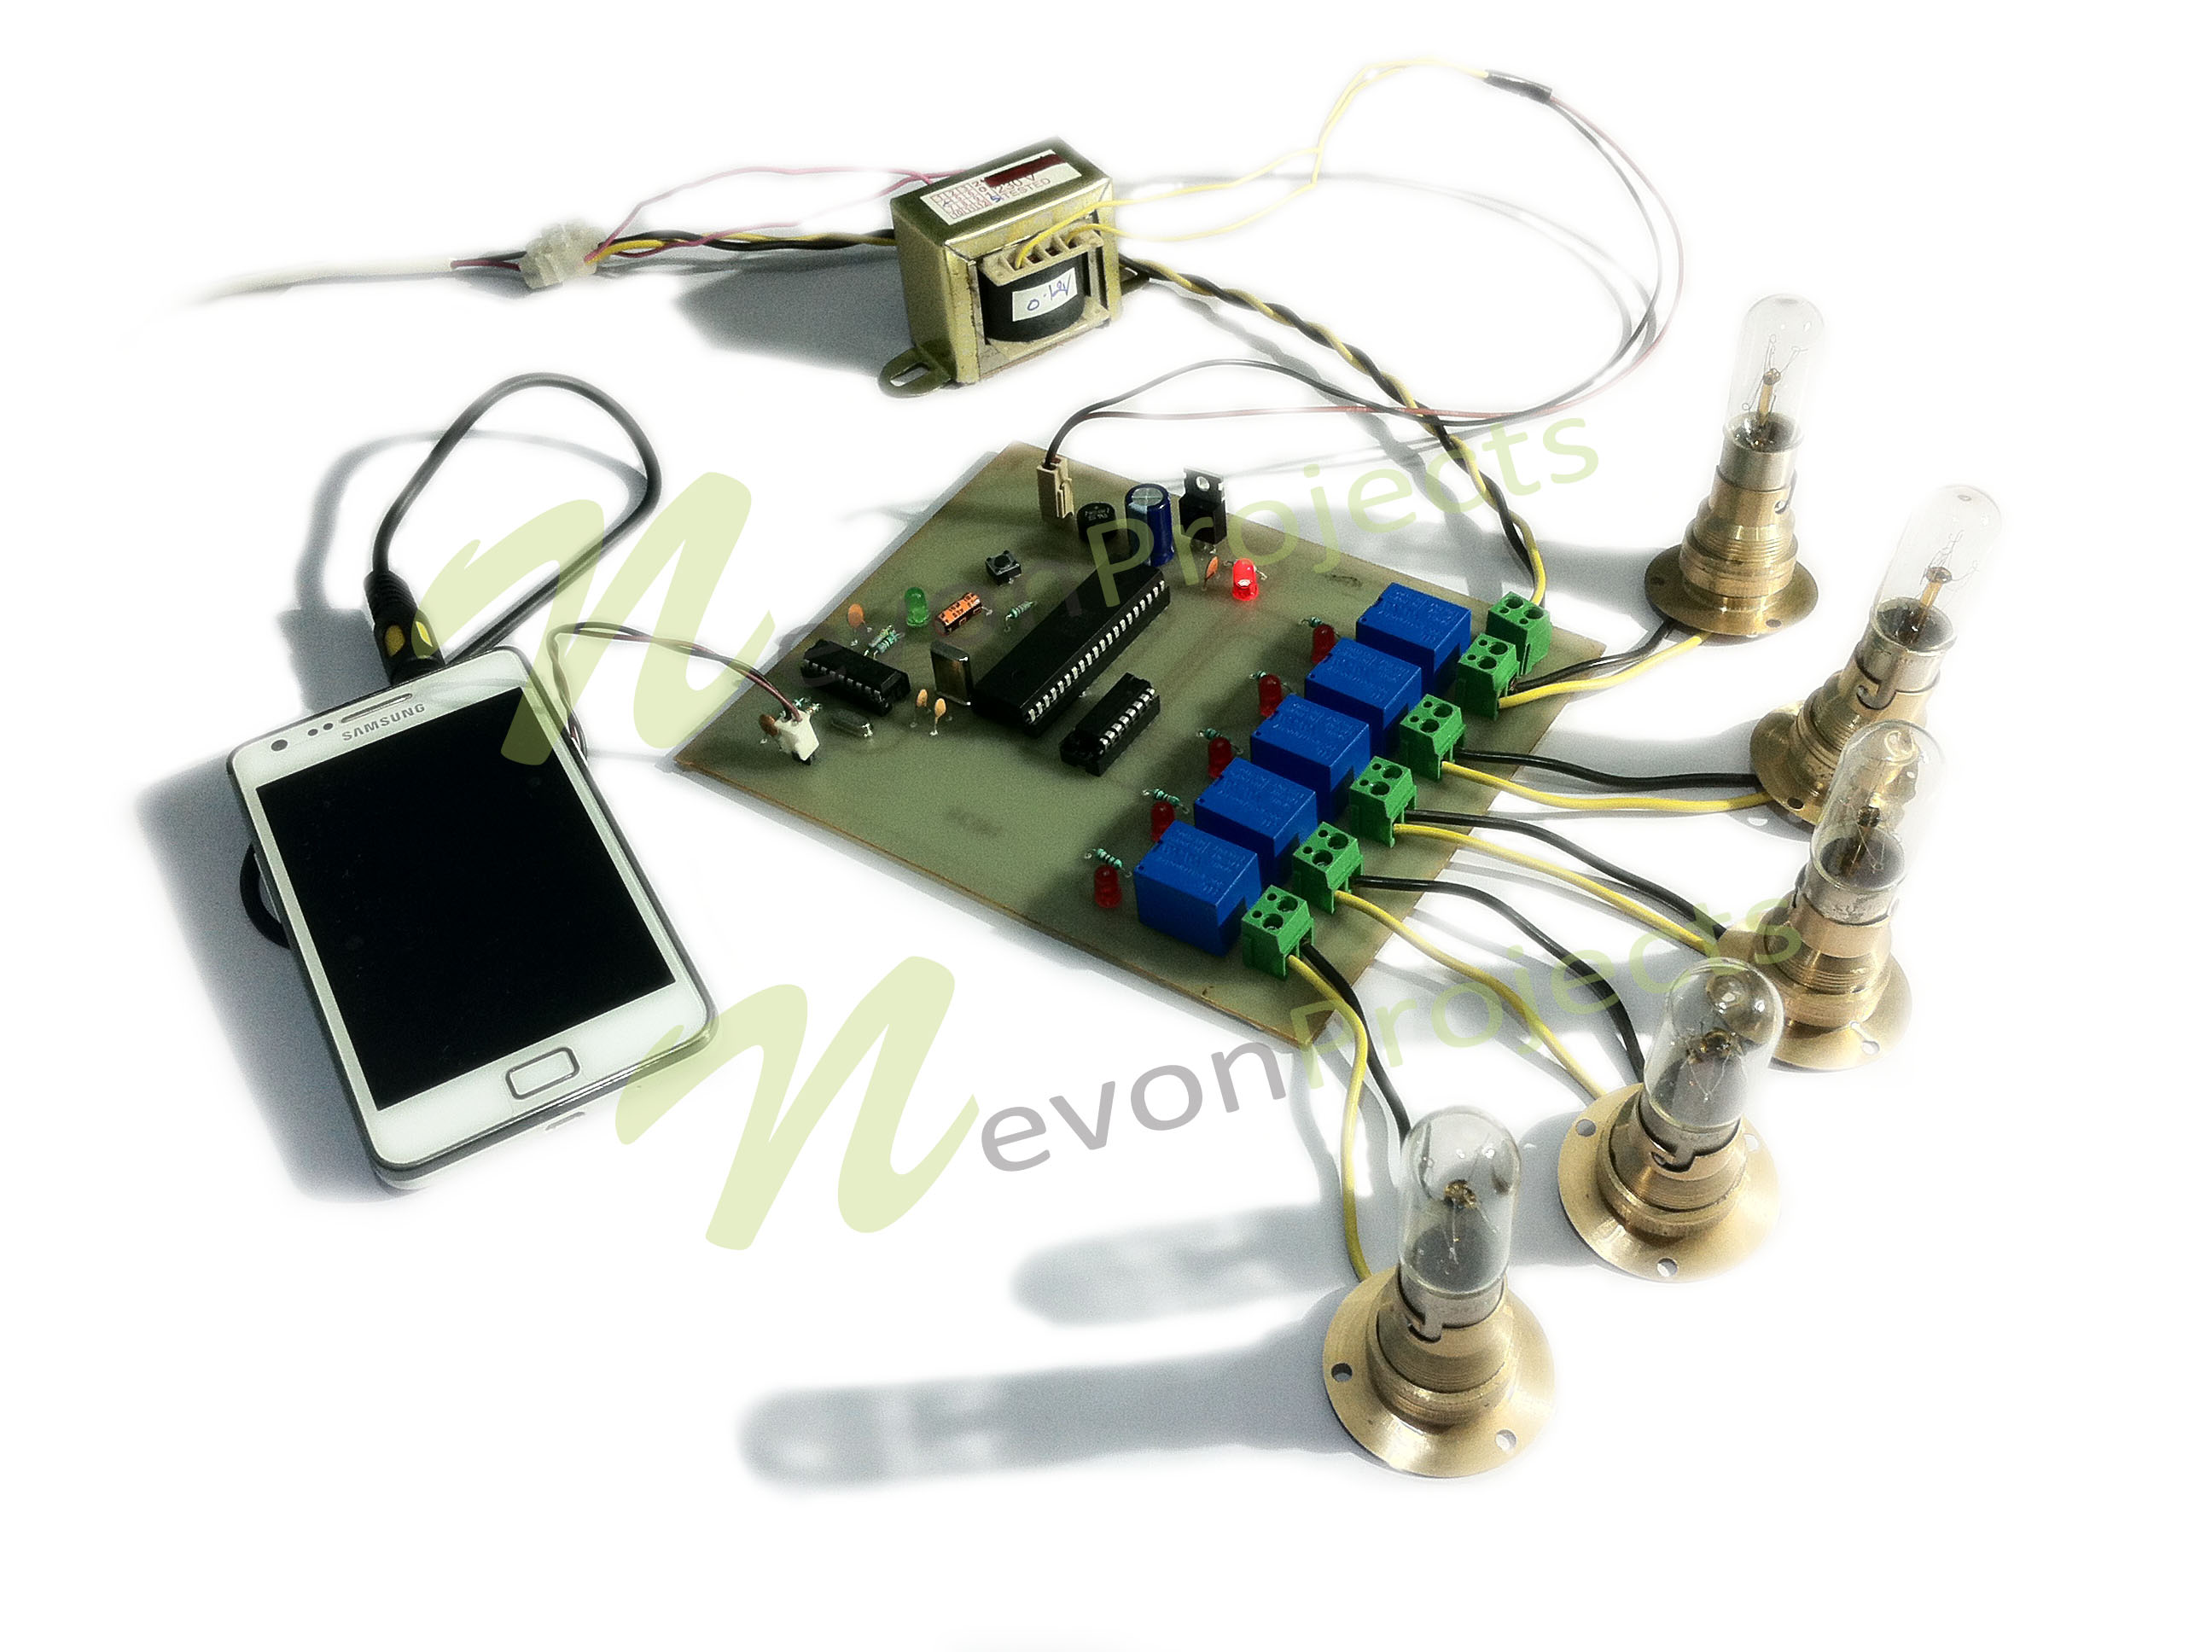
Problem Statement
Design and implement a load control system utilizing Dual-Tone Multi-Frequency (DTMF) technology. The system aims to facilitate remote control of electrical loads such as lights, fans, or appliances through phone calls or SMS commands, utilizing DTMF signals for communication. The primary objective is to create a reliable and user-friendly solution for managing and controlling electrical devices from a distance.

Slide 3
Abstract
The project aim at controlling various loads spread over a large area remotely by using DTMF concept. The DTMF commands tone received from the phone causes electrical load switching. The project is useful for managing industrial, domestic or agriculture loads that extends over a large area. The project of DTMF tone commands or received from any phone to remotely switch any electrical load.
The project requires a DTMF decoder interfaced to audio output socket of the cellphone. Whenever a button on the keypad is pressed the frequency thus generated from it is received by the decoder and it converts the frequency into its equivalent digital code. A microcontroller of 8051 family is used which is interfaced to relay driver IC. The digital code is then provided to microcontroller that identifies the phone commands and initiates the relays to actuate the respective loads by turning them on and off.

Slide 4
Literature Survey
S. No. | Title | Methodology | Metrics | Limitations
1. | Paper -1 Efficient Detection Approach for DTMF Signal Detection | dual-tone multi-frequency (DTMF); remote control; tone detection; Goertzel algorithm; discrete Fourier transform (DFT) | 8 | Noise sensitivity,cross-talk,frequency deviation
2 | Paper -2 Design of Load Control System Using DTMF | Requirement analysis, DTMF encoding and decoding,hardware selection,control algorithm | 501 | Limited control commands, security concerns, noise and interference
3 | Paper -3 Remote-control of multi appliances based latching circuit and DTMF | Digital comparator,DtMF,GSM,Home appliances,remote control,wireless | 25 | Limited appliance compatibility,complexity of installation, scalability,security concerns
4 | Paper -4 A model for automatic control of home appliances using DTMF technics | Automatic control, control of home appliances, DTMF,home automation, remote control | 1594 | Limited control range, dependency on infrastructure,interference and signal degradation

Slide 5
Literature Survey - Base paper
Paper 1: Efficient Detection Approach for DTMF Signal Detection
Authors: Cheng-Yu Yeh 1, and Shaw-Hwa Hwang
Published by & Year: 2019, applied science, MDPI
About paper:- A novel tone detection approach, designated as the multi-frequency detecting (MFD) algorithm, is presented in this work as an alternative to conventional single point detection approaches but it is an efficient way to achieve the aim of further computational load reduction for a dual-tone multi-frequency (DTMF) signal detection. The idea is that an optimal phase search is performed over the frequency band of interest in each tone detection, and then the optimal frequency response of a detector is built accordingly. In this manner, a DTMF detection task is done following one-time detection computation. This proposal demonstrates an overall computational load reduction of 80.49% and 74.06% in comparison with a discrete Fourier transform (DFT) approach and the Goertzel algorithm, respectively. This detection complexity reduction is an advantage and an important issue for applying DTMF detection technique to embedded devices.

Slide 6
Literature Survey - Base paper
Paper 2:Design of Load Control System Using DTMF
Authors: MM Abdullah1, MZ Hasan1, A. Muhyiddin Yusof1, A S F Rahman
Published by & Year:IOP publishing Ltd,2020
About paper:-. In agricultural sectors, one of the problems faced by the farmer is the water usage for watering schedule sometimes was wasted. With inefficient irrigation system, the water wastage could occur and resulting the excessive moisture for the soil and damaging the crops. The load control system in agricultural sectors especially for irrigation system is very important since it can affect the efficiency and the productivity of the operationsThe agricultural sectors also have many latest technologies implemented to the system such as irrigation system, temperature and humidity detection system and many other systems in order to operate efficiently so it can give profitable outcome.

Slide 7
Literature Survey - Base paper
Paper 3:Remote-Control of multi appliances based latching circuit and DTMF
Authors: Jabbar Shatti Jahool
Published by & Year: creative commons ,dec30,2021
About paper:-There are multiple technologies used to remotely control electric appliances like Wi-Fi, Bluetooth, global system for mobile (GSM), and dual-tone multifrequency (DTMF), but these technologies contain limitations, whether by coverage distance or by the number of devices that are controlled remotely. In this paper, these restrictions were overcome with the use of DTMF and digital latching devices, which doubles the number of remote-controlled electrical appliances compared to other research using the same intended technology DTMF. Using the proposed mechanism in this paper enables the users to effectively control several electric remote devices equal to the standard number of mobile keypad buttons, so in this way, can control 12 devices. This is via the mobile phone by sending commands in the form of analog tones through calling to auto-answer remote control panel phone (RCPP). An interesting feature of this research, each keypad key of the owner mobile (OM) using to control one remote electric device to switch it ON or OFF, so that the first pressing will cause to switch it ON and the second pressing caused to switching it OFF. This method is used instead of using two keypad keys, one for ON and the other for OFF. The proposed idea working is the same as manually switching but here remotely and electronically. This feature is achieved by using a D-latch digital circuit. The work is implemented and tested by using Proteus simulation program.

Slide 8
Literature Survey - Base paper
Paper 4: A model for automatic control of home appliances using DTMF technics
Authors: Kennedy Okokpujie, O.Modulo, Imhade P.Okokpujie, O.Abayomi-Ali
Published by & Year: Research Journal of Applied Sciences , July 2017
About paper:- Electrical devices and appliances cause a lots of problem and havoc if they are not switched off when they are not in use. This study developed a Dual Tone Multiple Frequency (DTMF) technology for the remote control of home appliances. A Dual Tone Multiple Frequency (DTMF) decoder MT8870, a mobile phone, a binary coded decimal decoder, a crystal pulse generator and other components were used for the model and development of the system. The dual tone multiple frequency decoder (MT887 0) receives and converts decimal signals to binary. The binary signals are further processed and converted back to binary by the binary coded decimal decoder. The processed signals are then sent to the relay for appropriate switching. Dedicated phone digits send commands to devices/appliances by switching them on or off. The simulation was done using MATLAB 7.0 using accuracy and convergence time as performance metrics. The simulation results showed that the DTMF based home automation has high percentage of accuracy transmitting. The convergence time result showed that signal transmitted took shorter time to converge. In conclusion, the developed model proves to be efficient in controlling home devices/appliances remotely.

Slide 9
Existing Systems
Existing load control systems using DTMF technology typically involve a combination of hardware and software components to enable remote control of electrical loads. Here's an overview of the components and functionality commonly found in such systems:
1. DTMF Generator.
2.DTMF Decoder
3.Microcontroller or Controller Unit
4.Relays or Solid-State Switches
5. User Interface
6. Communication Infrastructure
7. Power Supply
8. Scalability and Integration

Slide 10
Limitations
Limited Range
Dependence on Telecommunication Infrastructure
Noise and Interference Sensitivity
Limited Bandwidth for Command Encoding
Single-Channel Communication
Security Vulnerabilities
Compatibility Issues
Limited Feedback Mechanisms

Slide 11
Proposed System / Innovation
Introduction: Introduce the concept of integrating DTMF-based load control with IoT platforms to enhance functionality and connectivity.
System Architecture: Describe the system architecture, which consists of three main components:
DTMF-Based Control Unit: This unit receives DTMF signals from users via telephone or mobile devices.
Microcontroller or Embedded System: Processes the DTMF signals and communicates with IoT gateway.
IoT Gateway: Connects the load control system to the internet and interfaces with IoT platforms.
Integration with IoT Platforms: Discuss how the load control system interacts with IoT platforms such as AWS IoT, Google Cloud IoT, or Microsoft Azure IoT. The system should be capable of:
Sending status updates and alerts to the IoT platform.

Slide 12
Proposed System / Innovation
Security Considerations: Address security challenges associated with IoT-enabled systems, including data privacy, authentication, and secure communication protocols.
Implementation and Evaluation: Present the implementation details of the proposed system, including hardware components, software architecture, and integration with IoT platforms. Evaluate the system's performance in terms of reliability, scalability, energy efficiency, and user satisfaction through field trials or simulations.
Conclusion: Summarize the benefits of integrating DTMF-based load control with IoT platforms and discuss potential future enhancements and applications.

Slide 13
Modules
When designing a load control system using DTMF technology, several key modules need to be integrated to ensure its functionality and effectiveness. Here are the essential modules typically involved:
1. DTMF Encoder
2. DTMF Decoder
3. Microcontroller Unit (MCU)
4. Relay Driver Circuit
5. Power Supply Unit
6. User Interface
7. Communication Interface
8. Protection Circuits

Slide 14
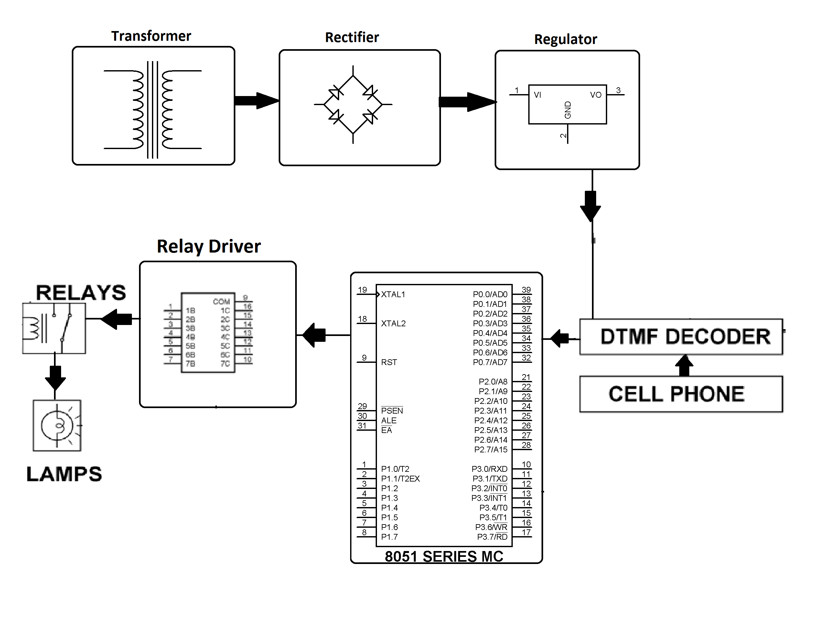
Block diagram

Slide 15
VIDYA JYOTHI INSTITUTE OF TECHNOLOGY (Autonomous)
THANK YOU

